Slide 1
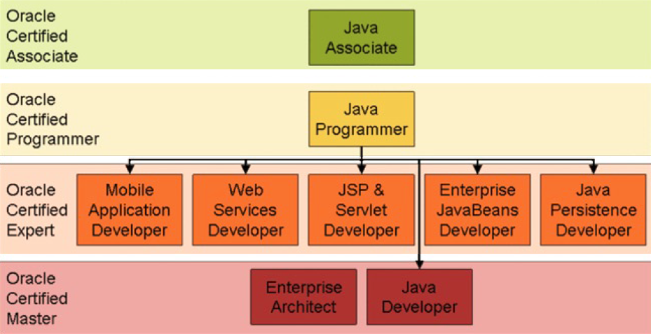
CERTIFIKAČNÝ PROGRAM PRE JAVA VÝVOJÁROV

Slide 2
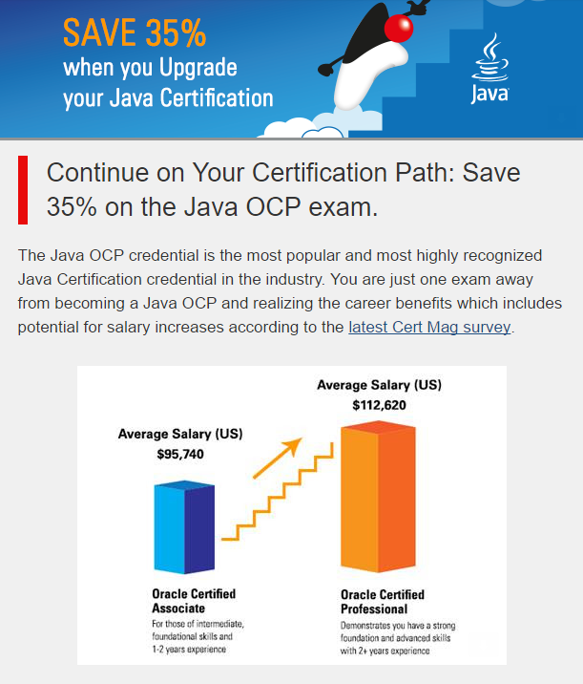
VÝHODY CERTIFIKAČNÉHO PROGRAMU

Slide 3
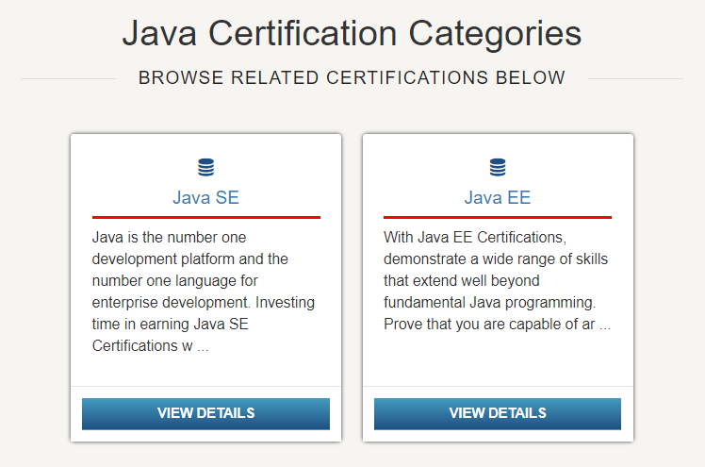
ORACLE JAVA CERTIFIKÁCIA

Slide 4
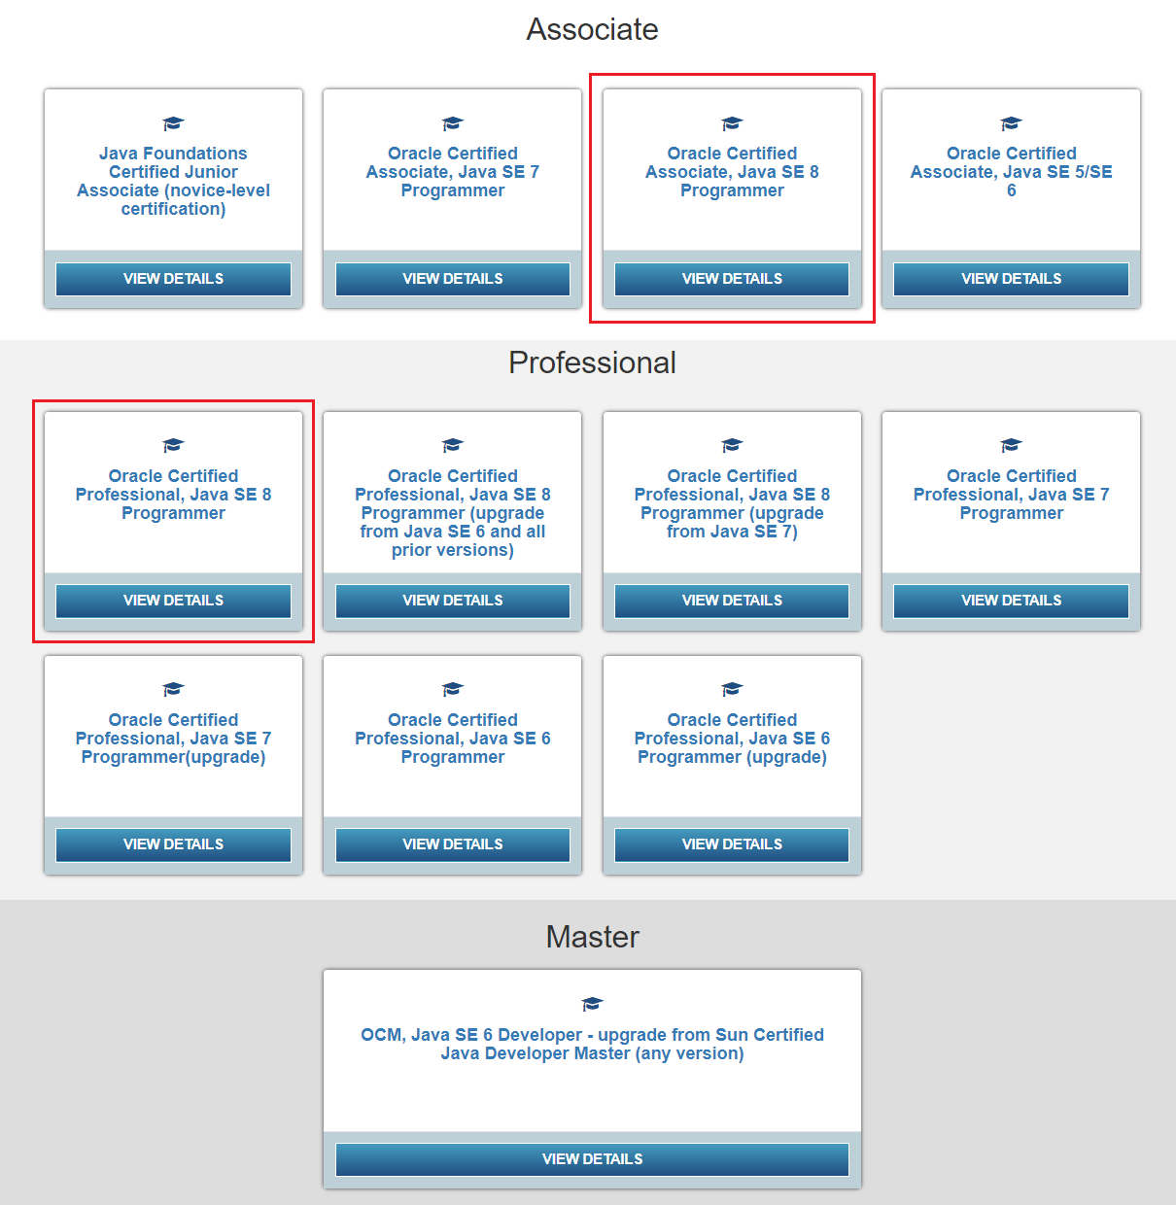
ORACLE JAVA CERTIFIKÁCIA

Slide 5
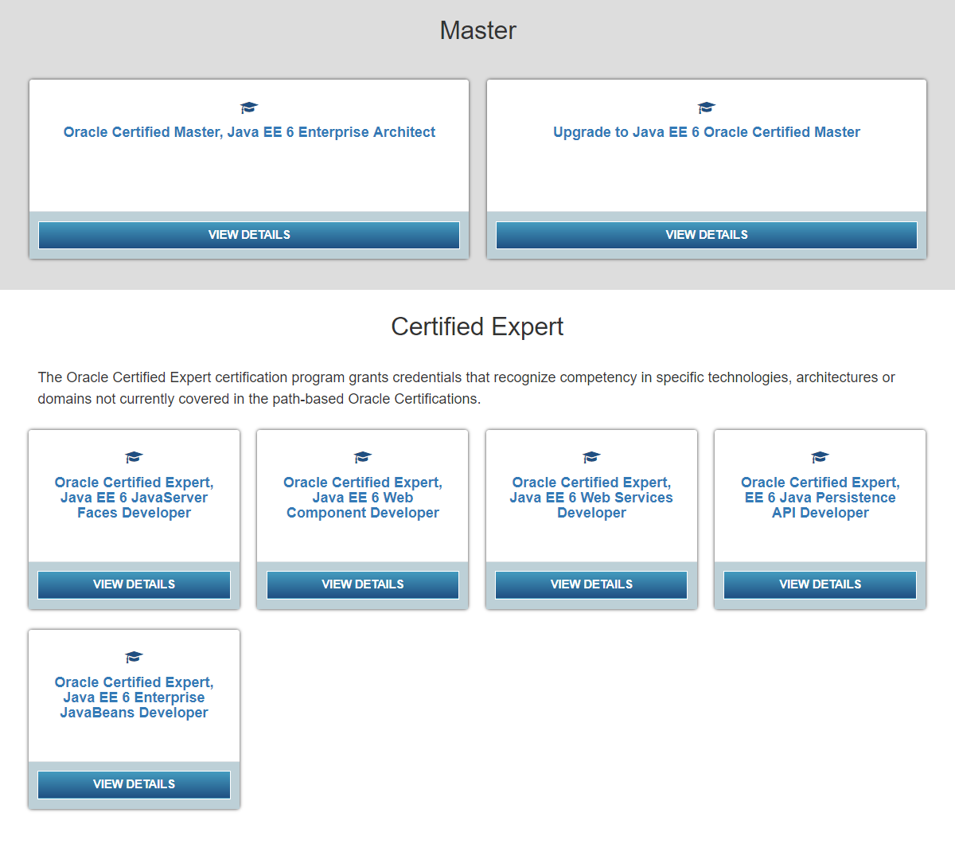
ORACLE JAVA CERTIFIKÁCIA

Slide 6
ORACLE JAVA CERTIFIKÁCIA
77 otázok, 150 minút, 212 Eur + dan, spolu 260 Eur
potrebných 65% správnych odpovedí, na poradí vypĺňania nezáleží
žiadne sankcie za zlé odpovede, preto treba aspoň skúsiť
otázky sú typu „choose all that apply“ – zvoľte všetky správne možnosti
vždy najprv skontrolujte syntaktické chyby - spočítajte zložené zátvorky a obyčajné zátvorky, skontrolujte ukončovacie bodkočiarky, pozor na malé a veľké písmená
Java SE certifikačné programy:
Oracle Certified Associate, Java SE 8 (7, 6) Programmer
Oracle Certified Professional, Java SE 8 (7, 6) Programmer
Oracle Certified Master, Java SE 7 Developer

Slide 7
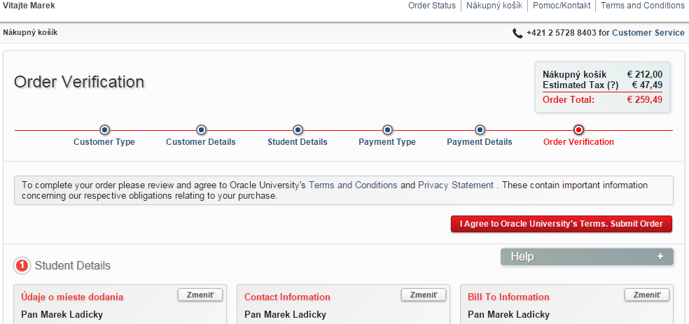
ORACLE JAVA CERTIFIKÁCIA
https://education.oracle.com/certification

Slide 8
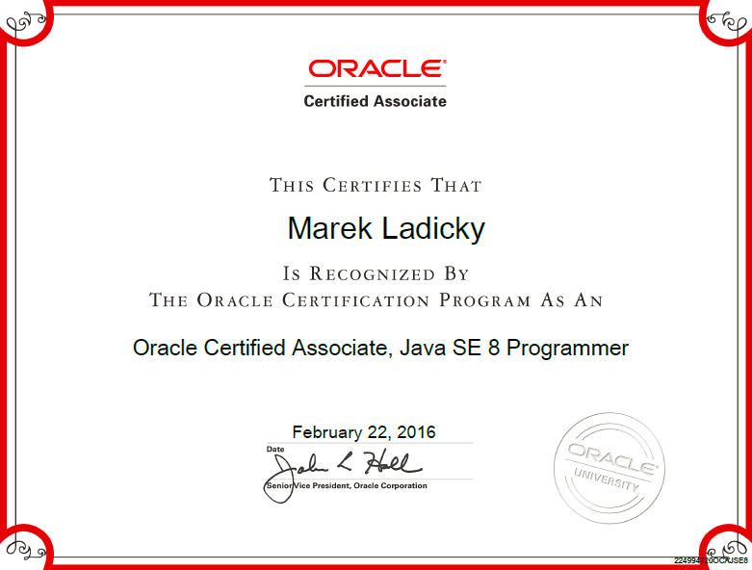
ORACLE JAVA CERTIFIKÁCIA

Slide 9
PRÍKLAD 1
What will be the output of the program?
class A {
final public int GetResult(int a, int b) { return 0; }
}
class B extends A {
public int GetResult(int a, int b) {return 1; }
}
public class Test {
public static void main(String args[]) {
B b = new B();
System.out.println("x = " + b.GetResult(0, 1));
}
}
A. x = 0
B. x = 1
C. Compilation fails.
D. An exception is thrown at runtime.

Slide 10
PRÍKLAD 2
What will be the output of the program?
class SC2 {
public static void main(String [] args) {
SC2 s = new SC2();
s.start();
}
void start() {
int a = 3;
int b = 4;
System.out.print(" " + 7 + 2 + " ");
System.out.print(a + b);
System.out.print(" " + a + b + " ");
System.out.print(foo() + a + b + " ");
System.out.println(a + b + foo());
}
String foo() {
return "foo";
}
}
A. 9 7 7 foo 7 7foo
B. 72 34 34 foo34 34foo
C. 9 7 7 foo34 34foo
D. 72 7 34 foo34 7foo

Slide 11
OKRUHY TÉM PRE OCA
Define the scope of variables (Definujte rozsah platnosti – životnosť – premenných)
public class T {
static int a = 34;
int b = 20;
{ b = 15; int c = 12; }
T() { b += 5; int d = 10; }
void doSomething() { int e = 5;
for (int z = 0; z < 3; z++) ;
}
}
a) Ktorá premenná má najväčší rozsah platnosti (scope)?
A. a B. b C. c D. d
b) Ktorá premenná/é má instance scope?
A. a B. b C. b, c, d D. c, d, e
c) Ktorá premenná/é má local scope?
A. a, b B. b, c C. b, c, d, e D. c, d, e, z

Slide 12
OKRUHY TÉM PRE OCA
Define the structure of a Java class (Definujte štruktúru triedy)
public class T {
private int a;
public static Date spustenieProgramu;
{ a = 50; }
static { spustenieProgramu = new Date(); }
public T() {}
void doSomething() { System.out.print(spustenieProgramu); }
private class X { public File f; }
private enum Abeceda {A, B, C, D}; }
Príklad uvádza všetky možné členy triedy, zhora: inštančná premenná; statická premenná triedy; inštančný inicializačný blok; statický inicializačný blok; konštruktor; inštančná metóda; vnorená trieda; vnorený enum.
Statická môže byť aj metóda, vnorená trieda a vnorený enum.

Slide 13
OKRUHY TÉM PRE OCA
Create executable Java applications with a main method including console output
Import other Java packages to make them accessible in your code
Apply encapsulation principles to a class and to a class members
Declare and initialize variables (including casting of primitive data types)
Differentiate between object reference variables and primitive variables
Know how to read or write to object fields

Slide 14
OKRUHY TÉM PRE OCA
Explain an Object's Lifecycle (creation, "dereference by reassignment" and garbage collection)
Develop code that uses wrapper classes such as Boolean, Double, and Integer
Use Java operators including parentheses to override operator precedence
Test equality between Strings and other objects using == and equals ()
Create if and if/else and ternary constructs
Use a switch statement

Slide 15
OKRUHY TÉM PRE OCA
Declare, instantiate, initialize and use one-dimensional and multi-dimensional array
Create and use for loops including the enhanced for loop
Create and use while and do/while loops and use break and continue
Create methods with arguments and return values including overloaded methods
Apply the static keyword to methods and fields
Create and overload constructors including impact on default constructors

Slide 16
OKRUHY TÉM PRE OCA
Determine the effect upon object references and primitive values when they are passed into methods that change the values
Describe inheritance and its benefits
Develop code that demonstrates the use of polymorphism including overriding and object type versus reference type
Determine when casting is necessary
Use super and this to access objects and constructors
Use abstract classes and interfaces

Slide 17
OKRUHY TÉM PRE OCA
Differentiate among checked exceptions, unchecked exceptions, and Errors
Create a try-catch block and determine how exceptions alter normal program flow
Describe the advantages of Exception handling
Create and invoke a method that throws an exception
Recognize common exception classes (such as NullPointerException, ArithmeticExcpetion, ArrayIndexOutOfBoundsException, ClassCastException)
Manipulate data using the StringBuilder class and its methods

Slide 18
OKRUHY TÉM PRE OCA
Creating and manipulating Strings
Create and manipulate calendar data using classes from java.time.LocalDateTime, java.time.LocalDate, java.time.LocalTime, java.time.format.DateTimeFormatter, java.time.Period
Declare and use an ArrayList of a given type
Write a simple Lambda expression that consumes a Lambda Predicate expression

